Slide 1
Freelance Forge: Functional Decomposition Diagram
Freelance Forge
1. Freelancer Registration
2. Client Registration
3. Account Management
4. Job Posting and Searching
5.Subscription Management
6. Freelancer-Client Linking
Venkata Puneeth
Nannapaneni
Naveen Kumar Kukutla,
Amar Gopal Kapalavai
Asritha Pallapotu
Sai Aneesh,
Akhil Yadati
Jensikumari Jasoliya,
Yugantkumar Gajera
Syed Adnan,
Dhvani Dilipbhai Borda

Slide 2
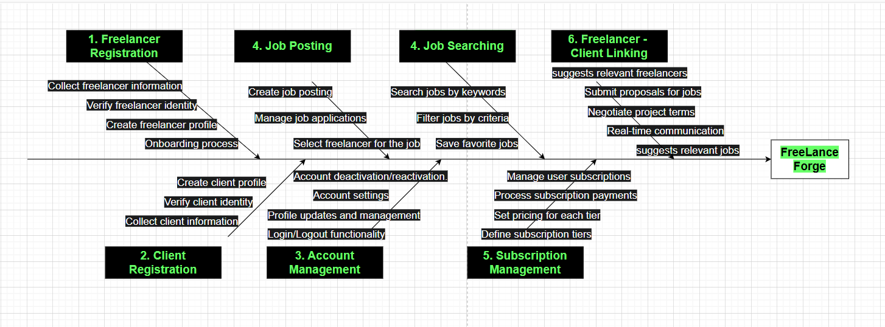
Freelance Forge: Fish Bone Diagram

